Slide 1
19CSE305: MACHINE LEARNING

Slide 2
Naive Bayes Classifier
Reference:
Machine Learning-Saikat Dutt, Coursera-Andrew ng, Statquest

Slide 3
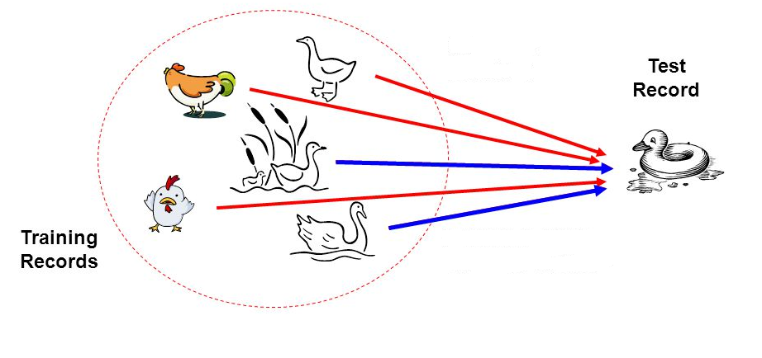
Bayesian Classifier
Principle
If it walks like a duck, quacks like a duck, then it is probably a duck

Slide 4
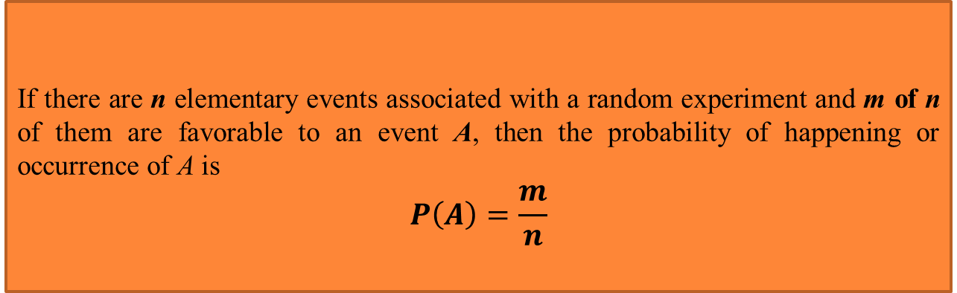
Probability-Basics
Simple Probability
If there are n elementary events associated with a random experiment and m of n of them are favorable to an event A, then the probability of happening or occurrence of A is
$$P\left(A\right)=\frac{m}{n}$$
Suppose, A and B are any two events then P(A), P(B) denote the probabilities that the events A and B will occur, respectively.

Slide 5

Probability-Basics
Mutually Exclusive Events:
Two events are mutually exclusive, if the occurrence of one precludes the occurrence of the other.
Example: Tossing a coin (two events)----- Head and Tail
Tossing a ludo cube (Six events)
Can you give an example, so that two events are not mutually exclusive?
Hint: Tossing two identical coins
Independent events: Two events are independent if occurrences of one does not alter the occurrence of other.
Example: Tossing both coin and ludo cube together.
(How many events are here?)

Slide 6
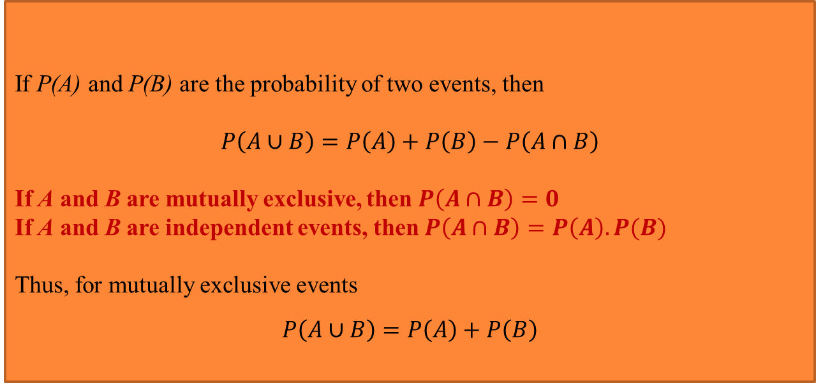
Probability-Basics
If P(A) and P(B) are the probability of two events, then
$$P\left(A∪B\right)=P\left(A\right)+P\left(B\right)−P\left(A∩B\right)$$
If A and B are mutually exclusive, then $P\left(A∩B\right)=0$
If A and B are independent events, then $P\left(A∩B\right)=P\left(A\right).P(B)$
Thus, for mutually exclusive events
$$P\left(A∪B\right)=P\left(A\right)+P\left(B\right)$$
Joint Probability

Slide 7
Probability-Basics
Conditional Probability
If events are dependent, then their probability is expressed by conditional probability.
Conditional probability is a measure of the probability of an event given that another event has already occurred.
If the event of interest is A and the event B is assumed to have occurred, "the conditional probability of A given B", or "the probability of A under the condition B", is usually written as P(A|B), or sometimes PB(A).
$$P\left(A | B\right)=\frac{Number of events in B which are favourable to A}{Number of events in B}$$

Slide 8
Probability-Basics
Conditional Probability Examples
Chances of cough
The probability that any given person has a cough on any given day maybe only 5%. But if we know or assume that the person has a cold, then they are much more likely to be coughing. The conditional probability of coughing given that person have a cold might be a much higher 75%.
Marbles in a Bag
2 blue and 3 red marbles are in a bag. What are the chances of getting a blue marble? ???
The chance is 2 in 5

Slide 9
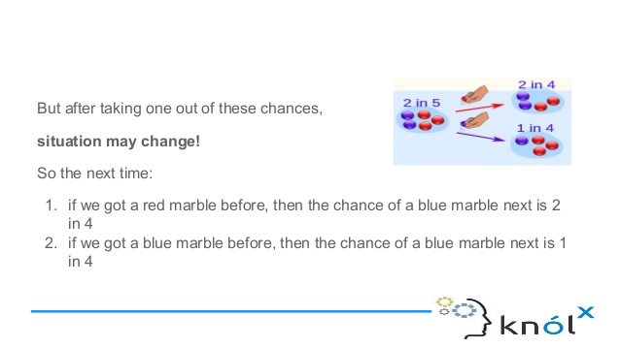
Probability-Basics
Conditional Probability Examples
But after taking one out of these chances,
situation may change!
So the next time:
if we got a red marble before, then the chance of a blue marble next is 2 in 4
if we got a blue marble before, then the chance of a blue marble next is 1 in 4

Slide 10
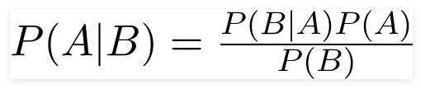
Bayes Theorem
In probability theory and statistics, Bayes’ theorem (alternatively Bayes’ law or Bayes' rule) describes the probability of an event, based on prior knowledge of conditions that might be related to the event.
Probability of A happening, given that B has occurred.
Basically, we are trying to find probability of event A, given the event B is true. Event B is also termed as evidence.
P(A) is the priori of A (the prior probability, i.e. Probability of event before evidence is seen). The evidence is an attribute value of an unknown instance(here, it is event B).
P(A|B) is a posteriori probability of A, i.e. probability of event after evidence is seen.

Slide 11
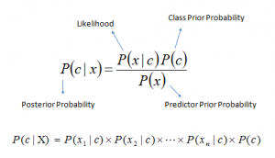
Bayes Theorem
P(c|x) is the posterior probability of class (c, target) given predictor (x, attributes).
P(c) is the prior probability of class.
P(x|c) is the likelihood which is the probability of predictor given class.
P(x) is the prior probability of predictor.

Slide 12
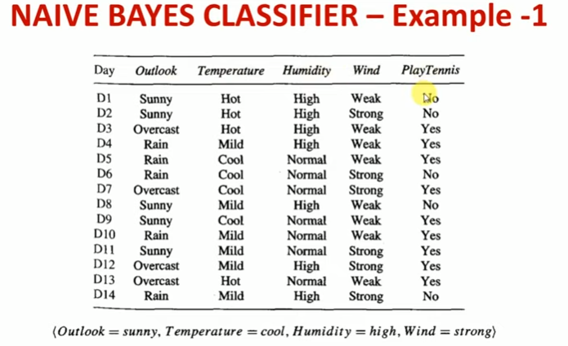

Slide 13
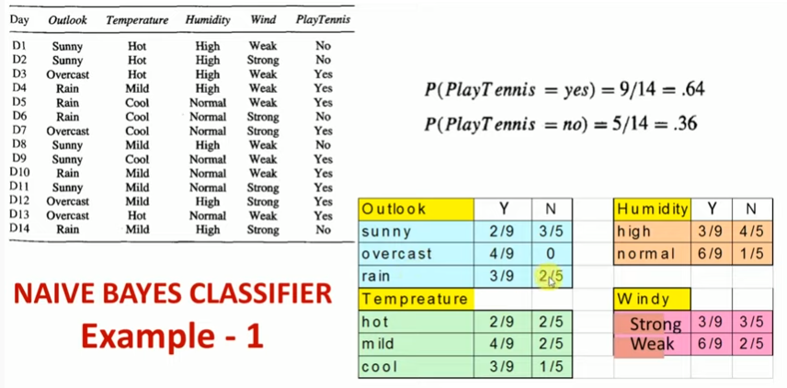

Slide 14
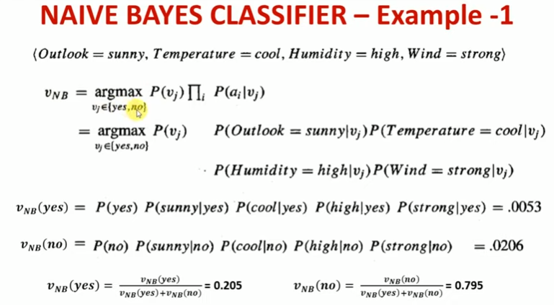

Slide 15
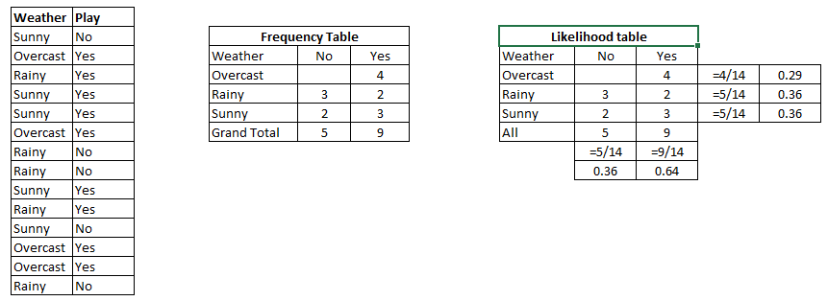
Example
Consider a training data set of weather and corresponding target variable ‘Play’ (suggesting possibilities of playing).
Step 1: Convert the data set into a frequency table.
Step 2: Create Likelihood table by finding the probabilities like Overcast probability = 0.29 and probability of playing is 0.64.
Step 3: Now, use Naive Bayesian equation to calculate the posterior probability for each class. The class with the highest posterior probability is the outcome of prediction.

Slide 16
Example
Step 1: Convert the data set into a frequency table.
Step 2: Create Likelihood table by finding the probabilities like Overcast probability = 0.29 and probability of playing is 0.64.

Slide 17
Example
Step 3: Now, use Naive Bayesian equation to calculate the posterior probability for each class. The class with the highest posterior probability is the outcome of prediction.
Problem: Players will play if weather is sunny. Is this statement is correct?
Calculate posterior probability of class yes
P(Yes | Sunny) = P( Sunny | Yes) * P(Yes) / P (Sunny)
P (Sunny |Yes) = 3/9 = 0.33
P( Yes)= 9/14 = 0.64
Now, P (Yes | Sunny) = 0.33 * 0.64
= 0.2112

Slide 18
Pros & Cons
PROS
It is easy and fast to predict class of test data set. It also perform well in multi class prediction
When assumption of independence holds, a Naive Bayes classifier performs better compare to other models like logistic regression and you need less training data.
It perform well in case of categorical input variables compared to numerical variable(s). For numerical variable, normal distribution is assumed (bell curve, which is a strong assumption
CONS
If categorical variable has a category (in test data set), which was not observed in training data set, then model will assign a 0 (zero) probability and will be unable to make a prediction. This is often known as “Zero Frequency”. To solve this, we can use the smoothing technique. One of the simplest smoothing techniques is called Laplace estimation.
Another limitation of Naive Bayes is the assumption of independent predictors. In real life, it is almost impossible that we get a set of predictors which are completely independent.

Slide 19
Applications
Real time Prediction: Naive Bayes is an eager learning classifier and it is sure fast. Thus, it could be used for making predictions in real time.
Multi class Prediction: This algorithm is also well known for multi class prediction feature. Here we can predict the probability of multiple classes of target variable.
Text classification/ Spam Filtering/ Sentiment Analysis: Naive Bayes classifiers mostly used in text classification (due to better result in multi class problems and independence rule) have higher success rate as compared to other algorithms. As a result, it is widely used in Spam filtering (identify spam e-mail) and Sentiment Analysis (in social media analysis, to identify positive and negative customer sentiments)
Recommendation System

Slide 20
Naive Bayes Classifier-Sklearn
from sklearn.naive_bayes import GaussianNB
model = GaussianNB()
# fit the model with the training data
model.fit(train_x,train_y)
# predict the target on the train dataset
predict_train = model.predict(train_x)
# predict the target on the test dataset
predict_test = model.predict(test_x)
print('Target on test data',predict_test)
https://scikit-learn.org/stable/modules/generated/sklearn.naive_bayes.GaussianNB.html

Slide 21
THANK YOU

